Slide 1
PROBLEM STATEMENT
Customer satisfaction has emerged as one of the most important factors that guarantee the success of online store; it has been posited as a key stimulant of purchase, repurchase intentions and customer loyalty. A comprehensive review of the literature, theories and models have been carried out to propose the models for customer activation and customer retention. Five major factors that contributed to the success of an e-commerce store have been identified as: service quality, system quality, information quality, trust and net benefit. The research furthermore investigated the factors that influence the online customers repeat purchase intention. The combination of both utilitarian value and hedonistic values are needed to affect the repeat purchase intention (loyalty) positively. The data is collected from the Indian online shoppers. Results indicate the e-retail success factors, which are very much critical for customer satisfaction.

Slide 2
PROBLEM UNDERSTANDING
In today world, where E-commerce is emerging very fast and became a very easy way to reach their customer more efficient way and providing more solution of product to customer. But today even every small player pushing themselves to reach customer and offering product through online platform. Day by day Customer have more option or choices available with them to whom they want to buy product which are available online easily.
So, E-retailer company where they find huge business opportunity in online business but with this opportunity they have to faced very tough competition with another player. Hence today for surviving, they must retain their customer and need to make sure customer not only buy product for first time but also, they should like their services and product so the intention of satisfying customer gets fulfilled and customer makes their purchase again and again.
In this report we have focused on finding various aspect of customer behaviour and customer psychology link to online shopping. So E retailer company get familiar with their customer which will help them to make business strategy or marketing strategy to improve their sales and capturing more target market share.

Slide 3
EDA STEPS & VISUALIZATIONS
Variable identification.
Statistical Summary of Categorical Variable.
Non-Graphical Univariate Analysis.
Graphical Univariate Analysis.
Bivariate Analysis
Checking Missing value
Correlation Analysis

Slide 4
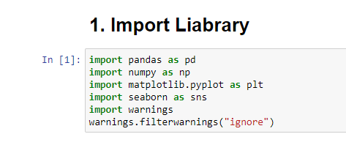
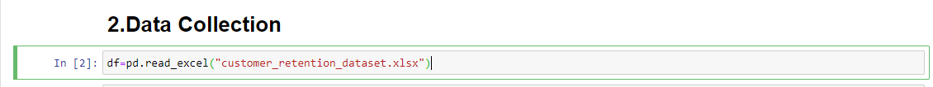
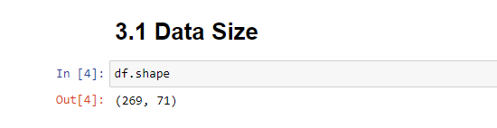
Variable identification.
Importing Libraries:
Importing Dataset:
Size of the dataset:

Slide 5
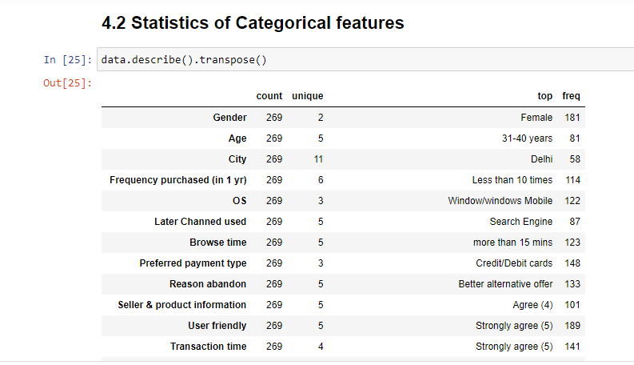
Statistical Summary of Categorical Variable.

Slide 6
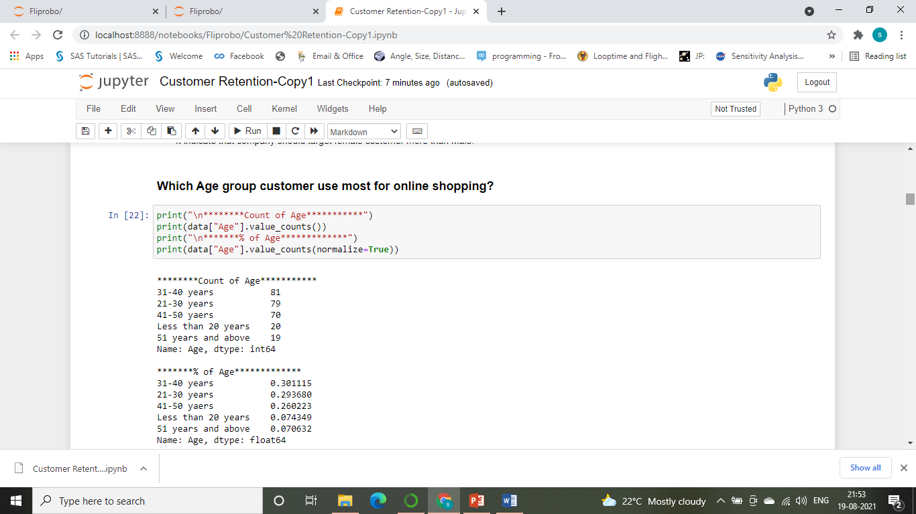
Non-Graphical Univariate Analysis.

Slide 7
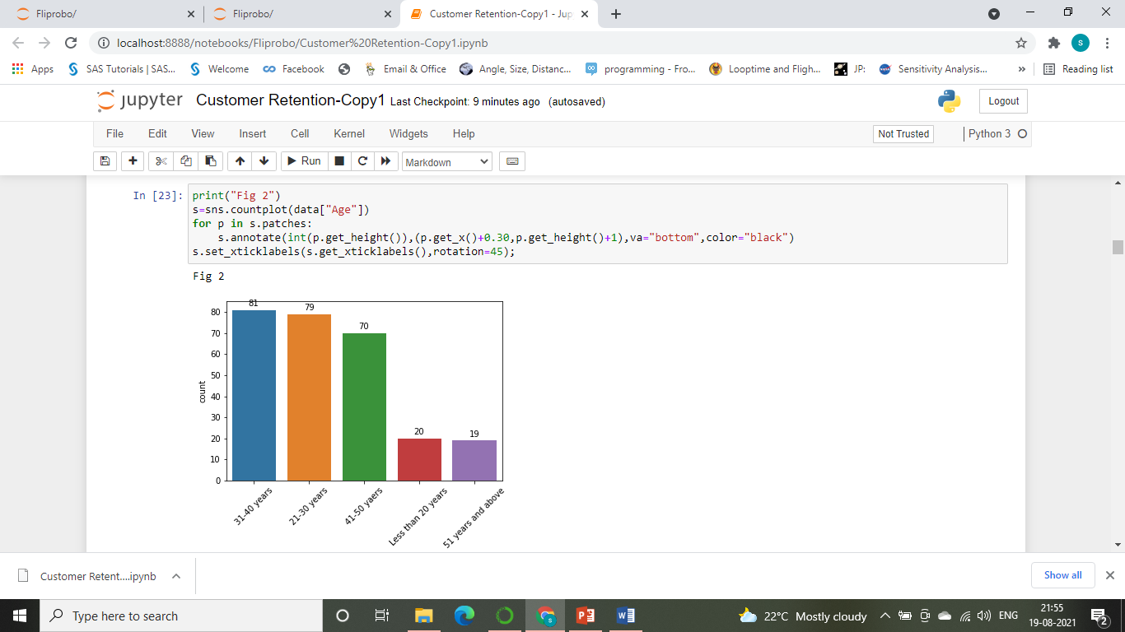
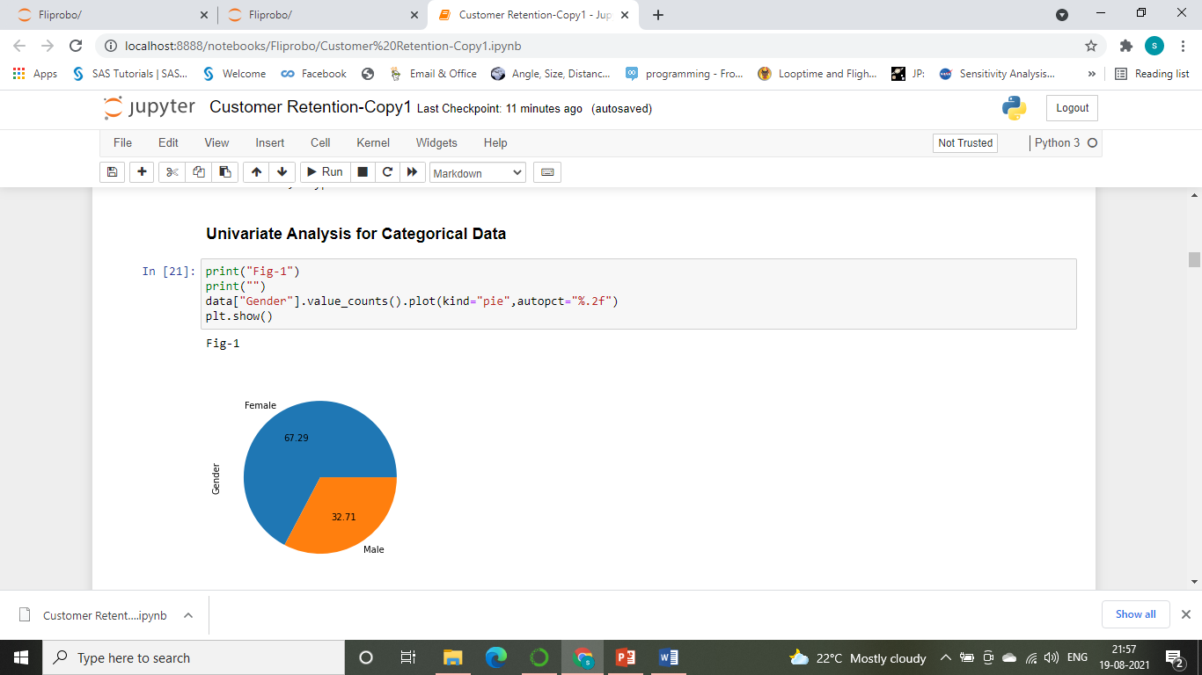
Graphical Univariate Analysis.

Slide 8
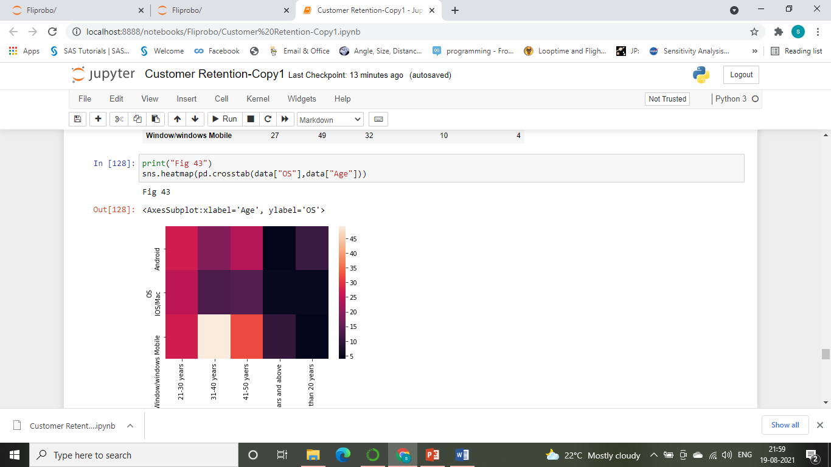
Bivariate Analysis

Slide 9
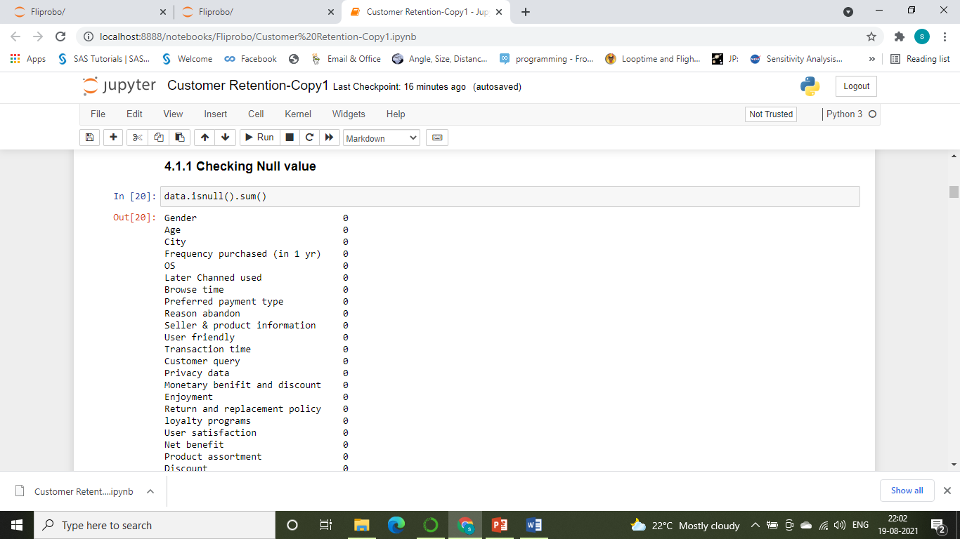
Checking Missing value

Slide 10
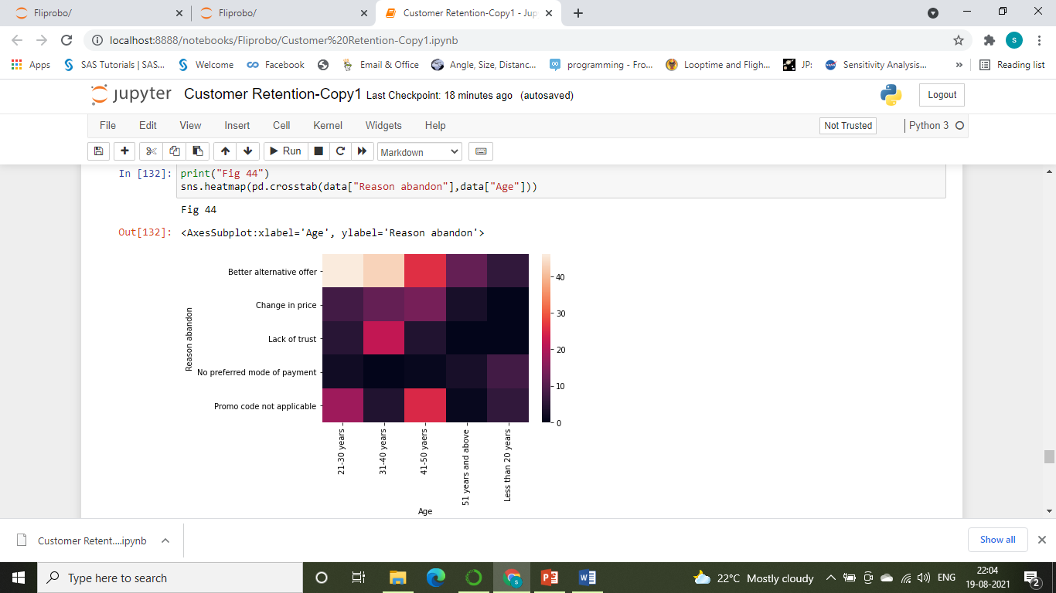
Correlation Analysis

Slide 11
DATA ANALYSIS PROCESS
STEP 1: Data requirement /Defining scope.
STEP 2: Data Collection.
STEP 3: Data Processing.
STEP 4: Data Analysis
Techniques based on Mathematics and Statistics
Techniques based on Visualization and Graphs
STEP 5: Infer and Interpret Results

Slide 12
Conclusion
Finding Key Point from Dataset for E-Retailer Company
E-Retailer Company should target on Female Customer more than male if the product can use for unisex as shown in Fig 1.
The Target Age group should be 31 yrs. to 50 yrs. for online shopping, within these group they need to find the best suited customer segment for their respective product.
Almost 42% of user they are shopping online less than 10 times in a year as shown in Fig 4, So we need to convert those customer to increase the frequency of shopping with Customer retention strategy.
As shown in fig 5, Almost 75% of online user they are using OS Windows/Windows mobile and Android for online shopping.
As shown in fig 6, Almost 64% of online user using search engine and installed apps for online shopping in 2nd time purchase.
As shown in fig 7, around 43% of customer spend 5 min to 16 min for online shopping.
As shown in fig 8, Almost 55% of customer preferred to pay for online shopping by using credit/debit cards.
As shown in fig 9, Around 49% of user Abandon the cart due to better alternative offer and 20% of user abandon the cart due to promo code not applicable.

Slide 13
Finding Key factors for E-Retailer company.
AMAZON.IN
STRENGTH: Visual appealing, Speedy Order Delivery time, Privacy of Information, Security transaction, Online Presence through different channel, Perceived trust, logged in time, Graphics display time, Website renovation, Experience after website renovation, most user recommend Amazon for online shopping
WEAKNESS: Late declaration price (during promotion period), Landing page time, Longer Delivery Period, Distortion while moving one page to another page
FLIPKART
STRENGTH: Visual appealing, Delivery Time, Privacy of information, Security transaction, Presence online, Perceived Trust, logged in time, Website renovation, Late declaration price, less disruption while moving one to another page.
WEAKNESS: Graphics display time, landing page time, Longer Deliver period.
Mynatra.in
STRENGTH: Late declaration price, Landing page time, Visual appealing.
WEAKNESS: Speedily delivery time, logged in time, Limited payment mode, Longer delivery period, After renovation experience.
PAYTM
STRENGTH: Late declaration price, landing page time, logged in time, website renovation.
WEAKNESS: Speedy delivery time, Presence online, Perceived trust, Graphics display time, Limited payment method
SNAPDEAL
STRENGTH: Graphics display time, Less Disruption while moving one page to another.
WEAKNESS: Visual appealing, Privacy information, Speedy delivery time, Security transaction, Website renovation

Slide 14
Strategy for Customer Retention for online shopper
E-Retailer Company should target on Female Customer more than male if the product can use for unisex as shown in Fig 1.
The Target Age group should be 31 yrs. to 50 yrs. for online shopping, within these group they need to find the best suited customer segment for their respective product. While doing marketing or promotion these age group should be targeted.
Majority of Customer shopping less than 10 times in a year, so usually they can target their customer for monthly shopping by provide wide range of product with intention of increasing the basket value.
While launching App or for advertisement the company should design by keeping in mind that its run well Windows/Windows mobile and Android Operating system. Since majority of customer use these OS.
Company should target in very well presence in search engine and also, they should encourage customer to install their app in local device.
Company should advertise their promotion in such a way that the message should be understandable or deliver within 15 minutes to customer.
For customer retention company must provide better experience while customer paying by credit/debit cards, they can provide some promotion or offer for electronic card holder.
Company should introduce more promo code and need to make sure these promo code reaches to target customer also the steps of redeemed those promo code.
Overall while company making their strategy or marketing plan, their objective must have covered below mentioned point for Repeat purchase by Customer:
User satisfaction, Gratification
Enjoyment, Social Status
Monetary benefit and discount ,Value for money
Product Assortment , Convenience
Discount

Slide 15
THANK YOU

